Slide 1
Retiree health plans
Get Set for Retirement | Insurance
2024

Slide 2
Important information
This presentation is not a comprehensive description of the insurance benefits offered by PEBA.
For more information, and before you make enrollment decisions, review the Insurance Benefits Guide.

Slide 3
State Health Plan
Self-funded insurance plan:
Members’ and employers’ premiums are held in a trust fund, and these funds are used to pay claims.
BlueCross BlueShield of South Carolina processes health claims.
Express Scripts processes prescription claims.
Cost of the State Health Plan compares favorably to other plans.
Learn more at peba.sc.gov/facts.
Health management is key to maintaining a low cost for the Plan and premiums.

Slide 4
State Health Plan provider network
Worldwide coverage.
You pay copayments, deductible and coinsurance.
Network provider files claims and accepts the Plan’s allowed amount, even if its charges are higher.
If you use an out-of-network provider, you may have to file claims and can be balance billed. You pay a higher coinsurance, too.
Use Find Care link under Resources at StateSC.SouthCarolinaBlues.com to find a network provider near you.

Slide 5
Non-Medicare-eligible health plan choices
State Health Plan, which includes prescription benefits.
Standard Plan.
Savings Plan.
TRICARE Supplement Plan, for eligible members of the military community.
TRICARE rules apply.
Coverage ends at age 65.

Slide 6
Standard Plan for non-Medicare-eligible members
Lower annual deductibles and higher monthly premiums.
Pay copayments for office visits, outpatient facilities and emergency care.
Pay copayments for prescription drugs.
Coverage of adult well visits for primary members ages 19 and older. Eligible female members can also receive an annual well woman visit at no member cost in addition to the annual adult well visit.
Evidence-based services with an A or B recommendation by the United States Preventive Services Task Force (USPSTF) included.

Slide 7
Savings Plan for non-Medicare-eligible members
High-deductible plan with lower monthly premiums.
No copayments.
Pay the allowed amount for prescription drugs until you meet your annual deductible. Then, you pay your coinsurance.
Coverage of adult well visits for primary members each plan year at no cost. Eligible female members can also receive an annual well woman visit at no member cost in addition to the annual adult well visit.
Evidence-based services with an A or B recommendation by the United States Preventive Services Task Force (USPSTF) included.
Eligible to contribute to a Health Savings Account (HSA) on a post-tax basis.

Slide 8
If you’re eligible for Medicare
Medicare will become your primary coverage and will start paying your claims first.
Your PEBA coverage will be your secondary coverage.

Slide 9
Enrolling in Medicare
Once eligible, you should enroll in Medicare Part A (hospital coverage) and Part B (medical coverage).
The Medicare enrollment period begins three months before your 65th birthday.
If receiving Social Security benefits, the Social Security Administration will contact you and enroll you automatically. Otherwise, you must contact Social Security to enroll.

Slide 10
2024 Medicare benefits
There is no Medicare or Medicare Supplemental Plan coverage outside the U.S. and U.S. territories.
Part A (hospital benefits) | Part B (medical benefits)
$1,632 deductible per benefit period.¹ No monthly premium if enough work credits established. | $240 annual deductible.¹ $174.70 (standard monthly premium as determined by Medicare). Plan pays 80% of approved charges.
¹Medicare deductibles are subject to change.

Slide 11
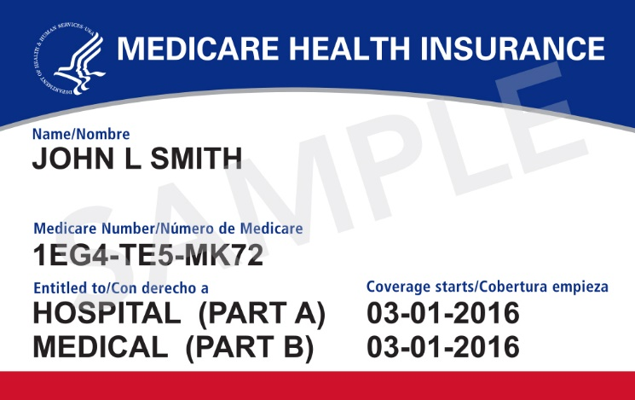
Becoming Medicare-eligible before age 65
You must notify PEBA and provide a copy of your Medicare card.
You can change health plans within 31 days of Medicare Part A eligibility.

Slide 12
Medicare-eligible health plan choices in retirement
State Health Plan, which includes prescription benefits.
Medicare Supplemental Plan.
Carve-out Plan.
See Insurance Coverage for the Medicare-eligible Member handbook for detailed information.

Slide 13
2024 Medicare Supplemental Plan benefits
Pays Medicare Part A deductible ($1,632).¹
Pays Medicare Part B deductible ($240).¹
Pays Medicare coinsurance, up to 100% of Medicare-approved charges.
Offers no coverage outside the U.S.
Includes prescription drug benefit.
Claims for non-Medicare subscribers are processed under the Standard Plan.
¹Medicare deductibles are subject to change.

Slide 14
Automatic enrollment in the Medicare Supplemental Plan
Automatic enrollment at age 65 for those who participate in the State Health Plan.
PEBA sends you a notification three months before your 65th birthday.
Can choose to opt out of the Medicare Supplemental Plan and be covered under the Carve-out Plan.
Medicare will be primary whether you opt out as long as you are not working in an insurance-eligible position on active coverage.
If you enroll in the Carve-out Plan in retirement, Medicare will still pay first toward your expenses.

Slide 15
2024 Medicare Supplemental Plan benefits example
If covered by Medicare and the Medicare Supplemental Plan, your claim will be processed like this:
Medicare-approved amount | $7,500
2024 Medicare Part A deductible¹ | - $1,632
Medicare payment | $5,868
Remaining bill | $1,632
Next, the Medicare Supplemental Plan benefits are applied:
Remaining bill | $1,632
Medicare Supplemental Plan pays Medicare Part A deductible | - $1,632
Your total payment | $0
¹Medicare deductibles are subject to change.

Slide 16
Carve-out Plan with Medicare
If your provider accepts the amount Medicare allows as payment in full, the Carve-out Plan will pay the lesser of:
The amount Medicare allows, minus what Medicare reported paying; or
The amount the State Health Plan would pay in the absence of Medicare, minus what Medicare reported paying.
Pays primary if outside the U.S. and U.S. territories, where Medicare is not accepted.
Learn more in the Insurance Coverage for the Medicare-eligible Member handbook.

Slide 17
2024 Carve-out Plan benefits example
If covered by Medicare and the Carve-out Plan, your claim will be processed like this:
Medicare-approved amount | $7,500
2024 Medicare Part A deductible¹ | - $1,632
Medicare payment | $5,868
Remaining bill | $1,632
Next, the Carve-out Plan benefits are applied:
State Health Plan allowed amount | $7,500
2024 Carve-out Plan deductible | - $515
Carve-out Plan allowance | $6,985
Carve-out Plan coinsurance | × 80%
Carve-out Plan payment in absence of Medicare | $5,588
Medicare payment is “carved out” of Carve-out Plan payment | - $5,868
Carve-out Plan payment | $0
Your total payment | $1,632
¹Medicare deductibles are subject to change.

Slide 18
Medicare and the TRICARE Supplement Plan
If enrolled in the TRICARE Supplement Plan, you can cancel or switch health coverage once reaching Medicare Part A eligibility.
TRICARE becomes TRICARE for Life, a Medicare supplement.

Slide 19
2024 Health plan premiums
Premium is determined by your coverage level:
Retiree;
Retiree/spouse;
Retiree/children; and
Full family.
Visit peba.sc.gov/monthly-premiums for details.
Rates may vary for optional employers, charter schools that participate in insurance only and employers that do not participate in the trust fund. Contact your benefits administrator for your premiums.

Slide 20
Tobacco-use premium
Applies to State Health Plan subscribers only.
$40 per month for subscriber-only coverage.
$60 per month for other levels of coverage.
Automatically charged unless subscriber:
Certifies as non-tobacco or e-cigarette user with Certification Regarding Tobacco or E-cigarette Use form; or
Certifies that all covered tobacco or e-cigarette users have completed the tobacco cessation program, Quit For Life.®

